Slide 1
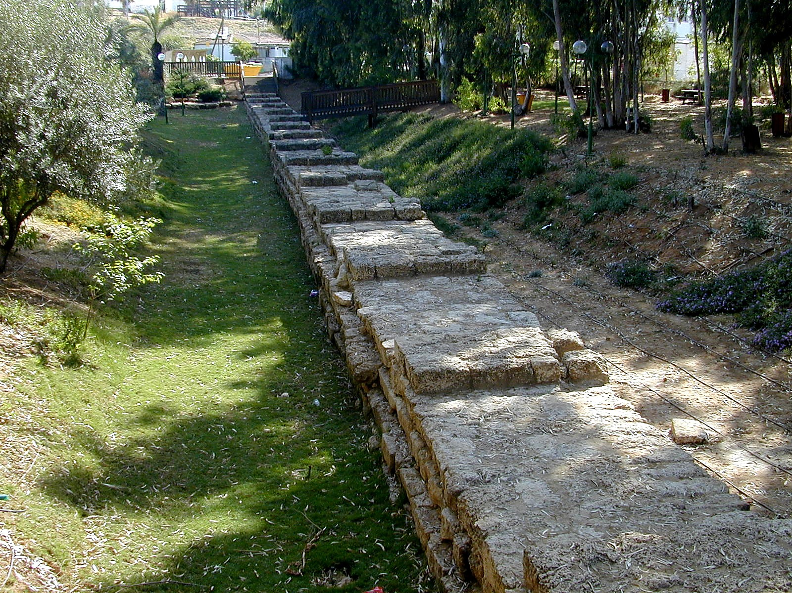
Strengthening Your Foundation
Dr. Rick Griffith • Jordan Evangelical Theological Seminary • BibleStudyDownloads.org

Slide 2

“in the beginning”
Gen. 1:1
Notes:
Who are you? To answer this, you need to see where you came from.
• This is why God gave us the Book of Genesis, which, in the Hebrew, is called “in the beginning.”

Slide 3
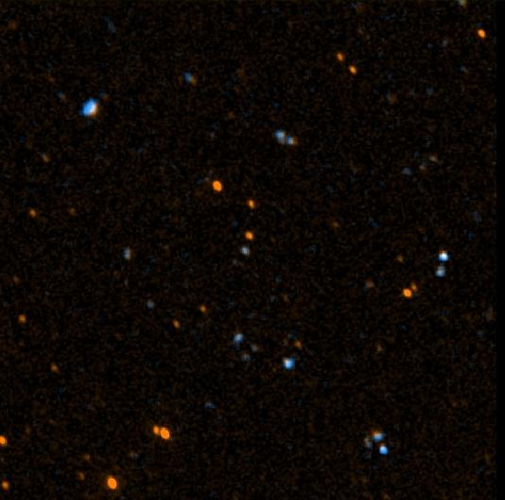


Genesis Title
Hebrew:
tyvarb
bereshith
In the beginning
Greek:
ge,nesij
genesis
Origin, source, birth
©2003 TBBMI
7.5.03a.
17
Notes:
We get our title of Genesis from the Greek for “origin, source, or birth.”

Slide 4

Genesis Questions
"Beginnings"
Where did we come from?
Why is there evil in the world?
Is there hope?
©2003 TBBMI
7.5.03a.
18
Notes:
People always want to know who they are, why things have gone wrong, and if there is hope. Can you answer these basic questions? Of course you can, but do you know why? Because of Genesis!

Slide 5
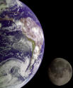
Narrative Parallels to Genesis
Memphite Theology
Enuma Elish
Atrahasis Epic
Gilgamesh Epic
Creation
Creation
Creation & Flood
Flood
Notes:
Moses was not the first to record man’s beginnings. Actually, some pagan versions of the creation and the flood were written hundreds of years before Moses. But Ancient Near East religions were polytheistic with ridiculous explanations of their origins.

Slide 6
Black
Notes:
Sumerians said that the high god raped the air goddess, resulting in the moon god.
Babylonians taught that king of the created gods (Marduk) murdered his mother (Tiamat) and cut her into two halves that became the land and sea (cf. Gen. 1:6-8).
So the world started from a son murdering his mother!

Slide 7
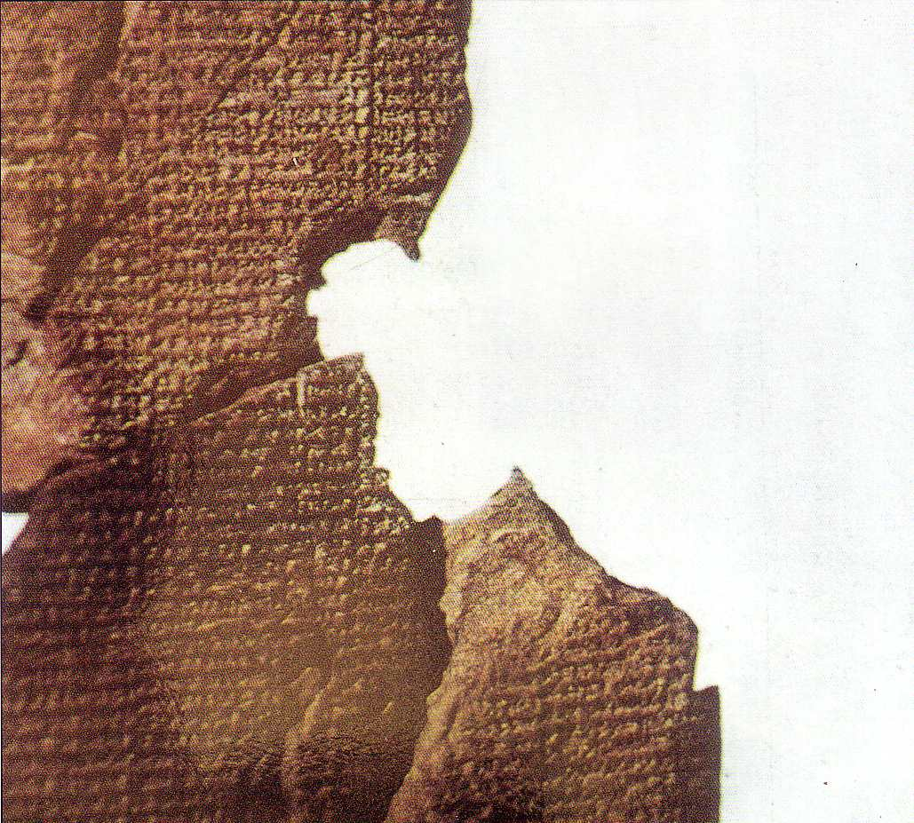
Atrahasis Epic
“Let the birth-goddess create offspring, and let man bear the toil of the gods… create humanity that he may bear the yoke… let Nintu mix clay, that god and man may be thoroughly mixed in the clay, let there be a spirit from the god's flesh”
(Arnold/Beyer, 24)
Akkadian 1650 BC
Creation & flood stories
Man created to help overworked gods
Man made from clay
Notes:
The Atrahasis Epic says that the greater gods created the lesser gods to do manual labor, but they got tired of this so they created man to do the work instead!

Slide 8
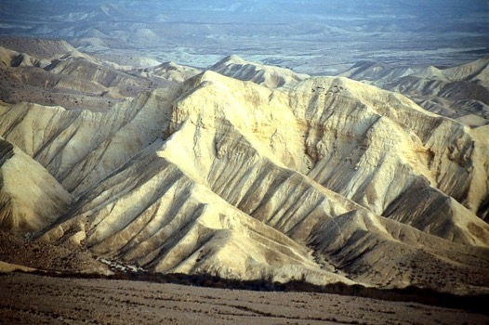
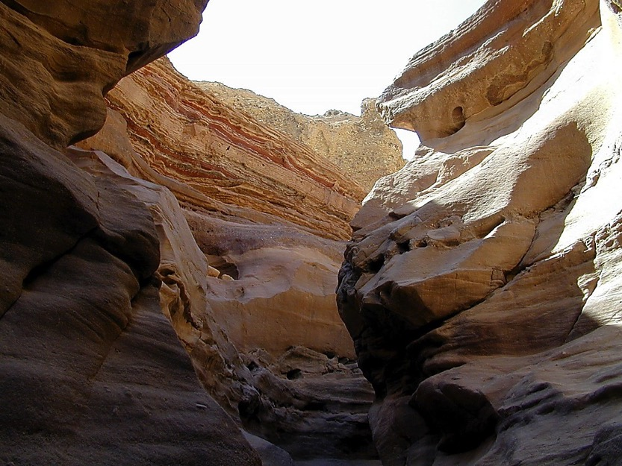
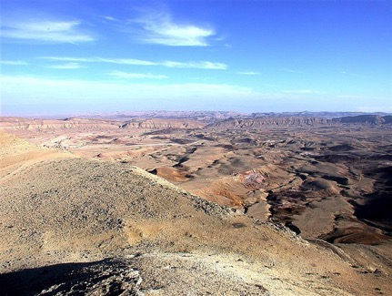
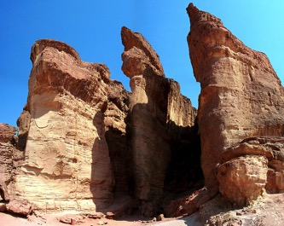
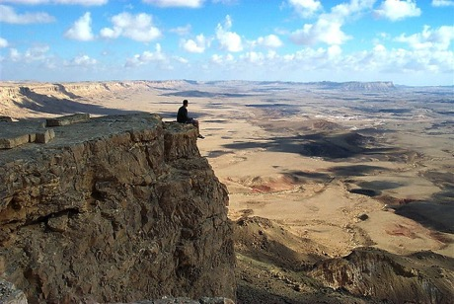
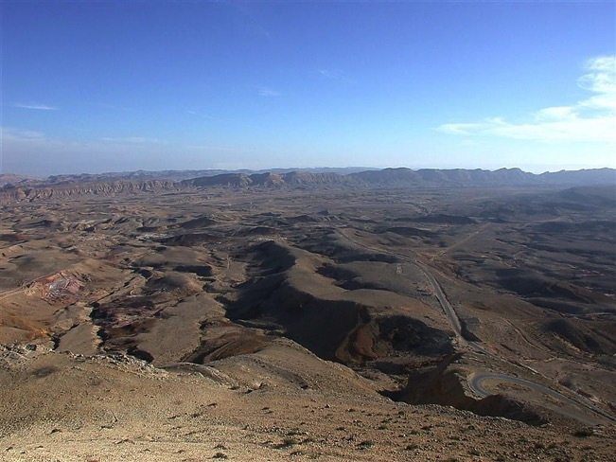
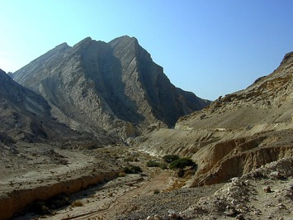
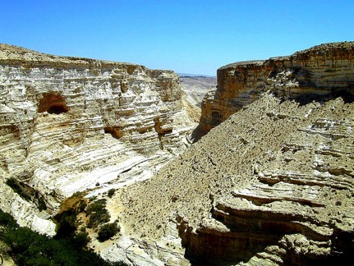

Num. 32:13
DRESSING
THE
STAGE
YOU MEAN… 40 YEARS? OUT HERE?
YOU MEAN… 40 YEARS? OUT HERE?
YOU MEAN… 40 YEARS? OUT HERE?
MOSES
Exodus
Sinai
M - C - C
Kadesh Barnea
40
40
Handbook pg. 26-29
23
Notes:
What’s the background to the Genesis creation account?
Israel had been under God’s discipline for 40 years in the desert.

Slide 9

Jericho
DEAD SEA
JORDAN RIVER
MODERN JERICHO
JOSHUA
Jericho/Ai
ANCIENT JERICHO
From Jericho...
Looking East Across the Jordan River
Handbook pg. 26-29
42
Notes:
Jews in the desert were about to cross over into Jericho. Canaan had horrible origin myths and practices of child sacrifice. So how would Israel stand up against these powerful peoples after Moses was gone?

Slide 10
Black
How do we fight the pagan philosophies of our day?
Notes:
So Genesis 1 answers these crazy notions of how the world began and gives what Israel needed to know about their God to defeat Canaan. It does the same for us by letting us know where we came from. It answers this question:

Slide 11

Where are we going?
Genesis 1
Response
Challenges
Notes:
Today we will first look at Genesis 1,
• secondly see similar pagan challenges of our day,
• and finally learn how to respond to these beliefs.

Slide 12
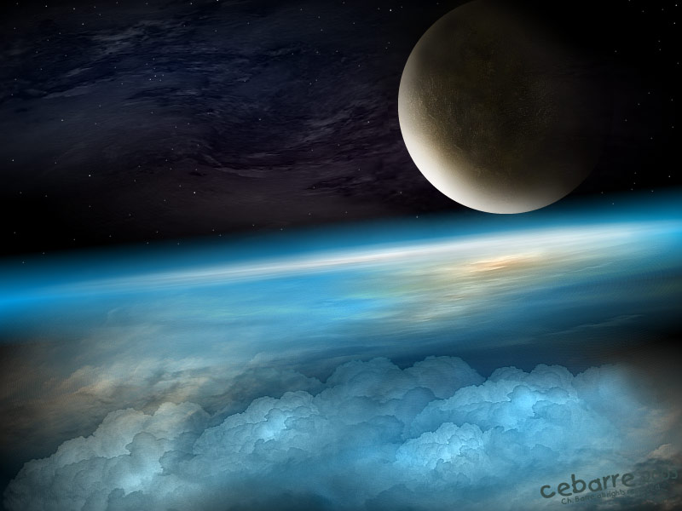
I. Our God is King who created everything in contrast to man-made ideas
(Gen. 1).
Notes:
Genesis 1 tells us that the LORD made all we see as evidence that he is the boss, even though we invent our own theories of origins.

Slide 13

Days of Creation
33
Void
Formless
Forming
Filling
Day 4: Sun, moon & stars arranged
Day 1: Light
Day 2: Water & air separated
Day 5: Fish & fowl
Day 3: Land & sea separated
Day 6: Animals & man
Genesis 1:3-31
Notes:
The account gives six days of forming and filling.

Slide 14
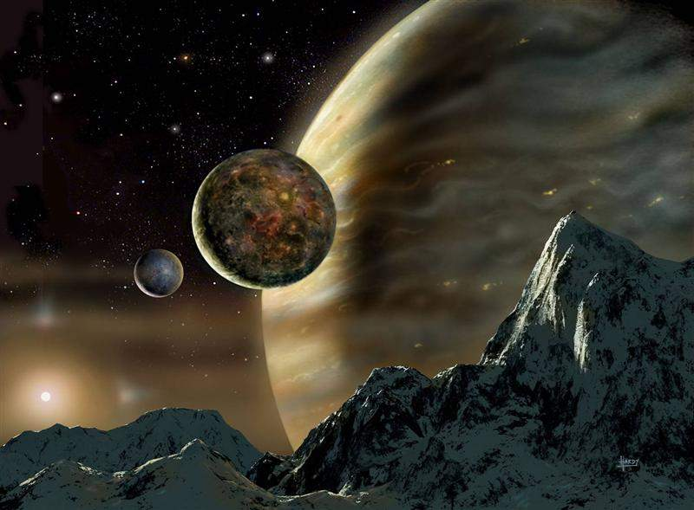
Creation in Six Days
Notes:
Let’s read Genesis 1 together from the screen. You will see some great pictures, but guess who did the Photoshop? God!

Slide 15
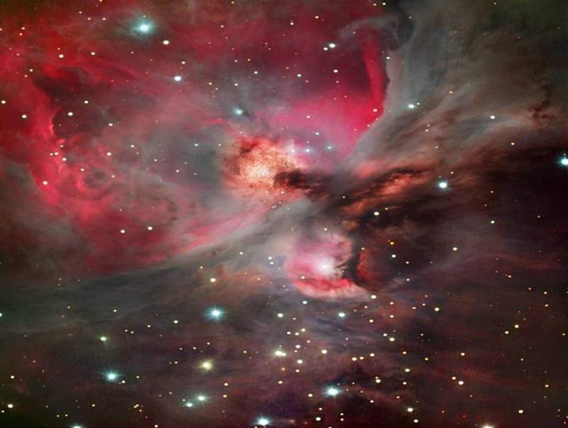
Day 1
God's Creation…Day 1
In the beginning God created
the heavens and the earth (1a).

Slide 16
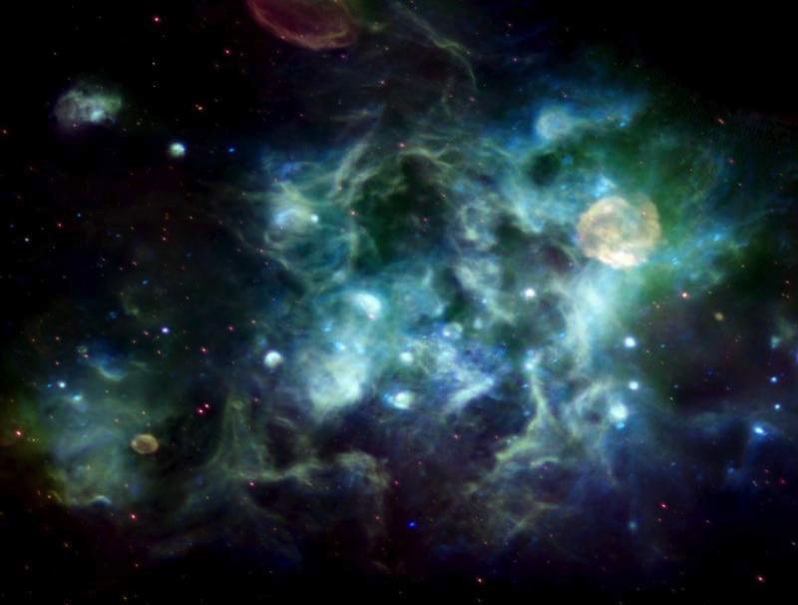
Formless & Void
God's Creation…Day 1
The earth was formless and void, and darkness was over the surface of the deep, and the Spirit of God was moving over the surface of the waters (2).

Slide 17
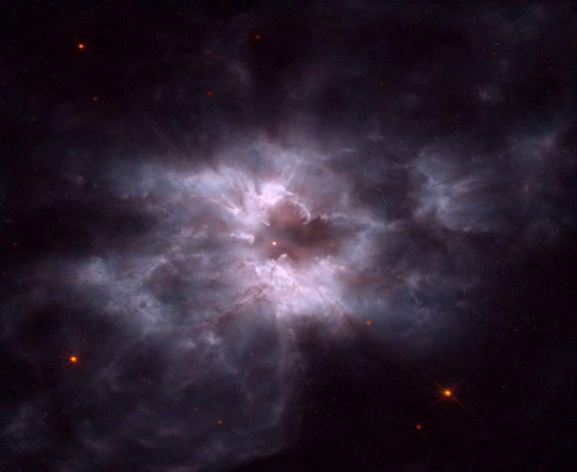
Light
God's Creation…Day 1
Then God said, “Let there be light”; and there was light. God saw that the light was good, and he separated the light from the darkness (3-4).

Slide 18
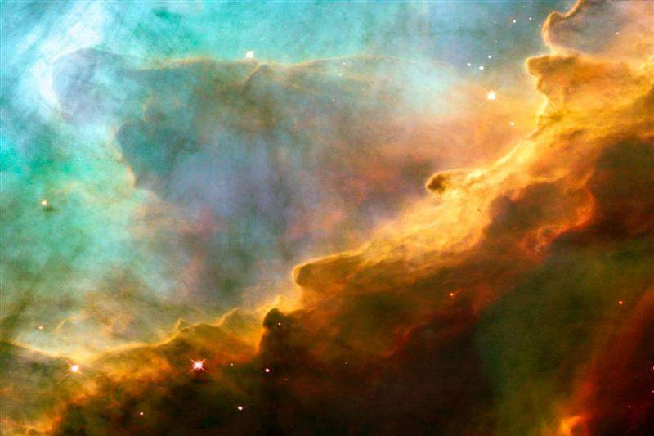
First Day
God's Creation…Day 1
God called the light day, and the darkness He called night. And there was evening and there was morning, one day (5).

Slide 19
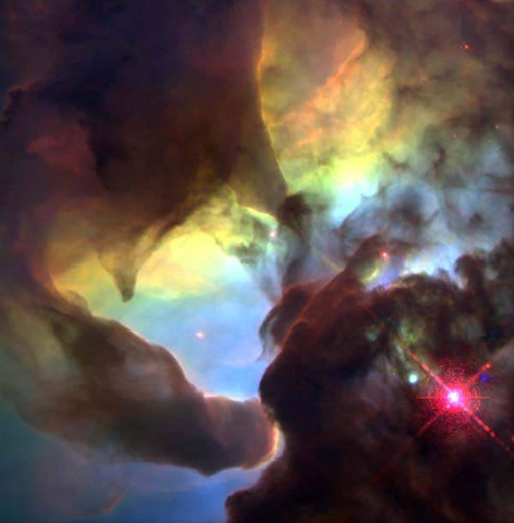
Day 2
God's Creation…Day 2
Then God said, “Let there be an expanse in the midst of the waters, and let it separate the waters from the waters” (6).

Slide 20
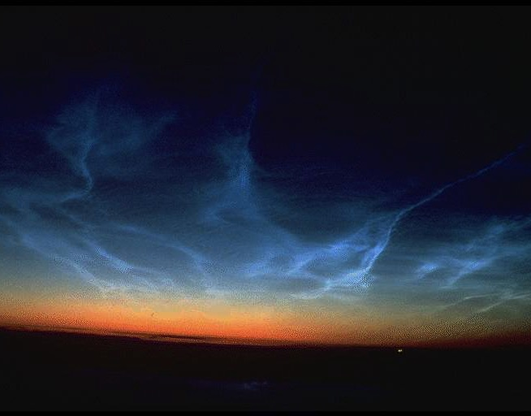
Expanse
God's Creation…Day 2
God made the expanse, and separated the waters which were below the expanse from the waters which were
above the expanse; and it was so (7).

Slide 21

Sky
God's Creation…Day 2
God called the expanse heaven (NIV “sky,” 8a).

Slide 22
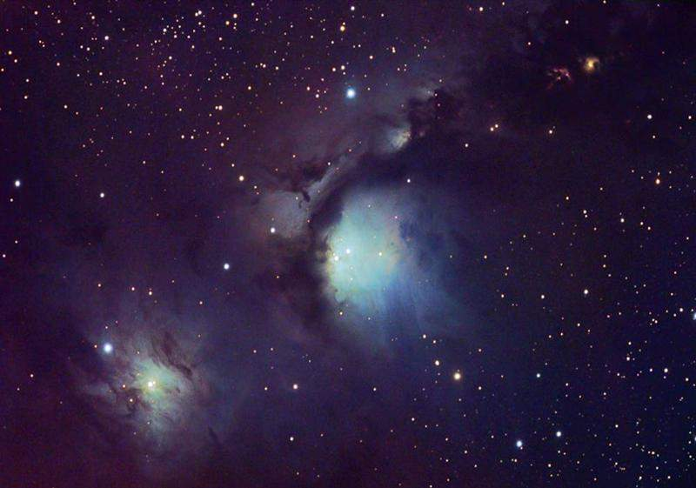
Second Day
God's Creation…Day 2
And there was evening and morning, a second day (8b).

Slide 23
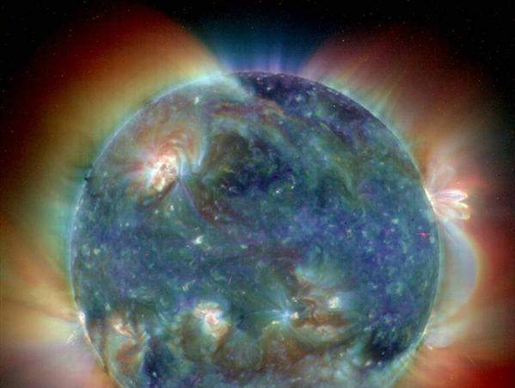
Day 3
God's Creation…Day 3
Then God said, “Let the waters below the heavens be gathered into one place, and let the dry land appear”; and it was so (9).

Slide 24
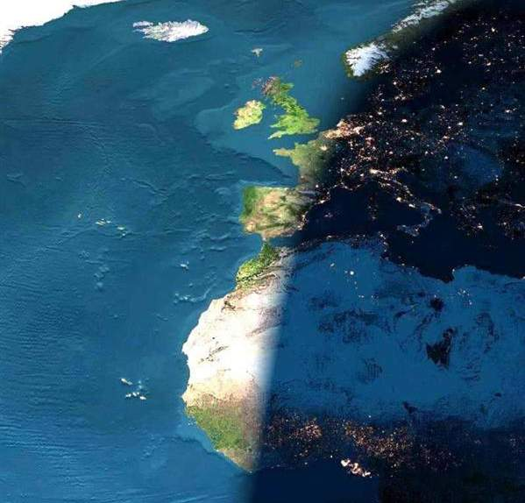
Land & Seas
God's Creation…Day 3
God called the dry land earth, and the gathering of the waters He called seas; and God saw that it was good (10).

Slide 25
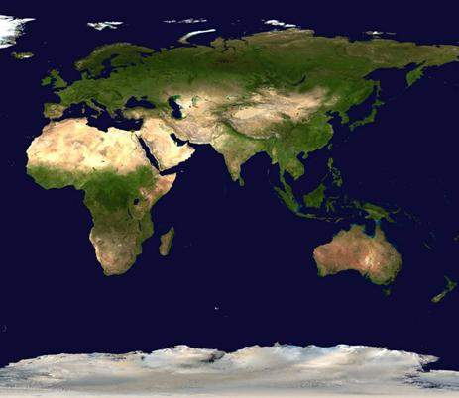
Vegetation
God's Creation…Day 3
Then God said, “Let the earth sprout vegetation: plants yielding seed, and fruit trees on the earth bearing fruit after their kind with seed in them,” and it was so. The earth brought forth vegetation, plants yielding seed after their kind, and trees bearing fruit with seed in them, after their kind; and God saw that it was good (11-12).

Slide 26
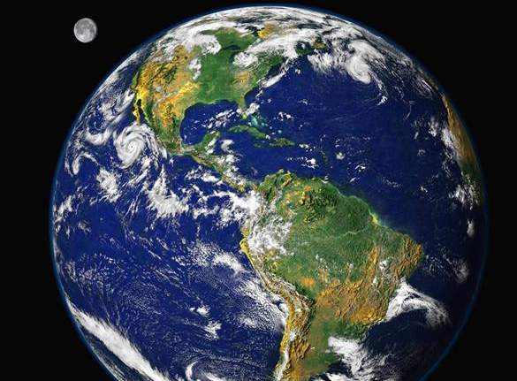
Third Day
God's Creation…Day 3
There was evening and there was morning, a third day (13).

Slide 27
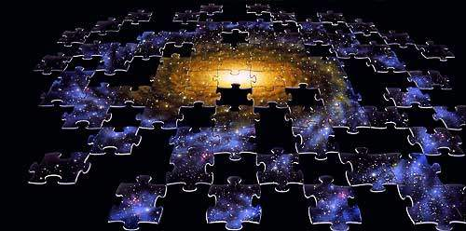
Day 4
God's Creation…Day 4
Then God said, “Let there be lights in the expanse of the heavens to separate the day from the night, and let them be for signs and for seasons and for days and years (14);

Slide 28
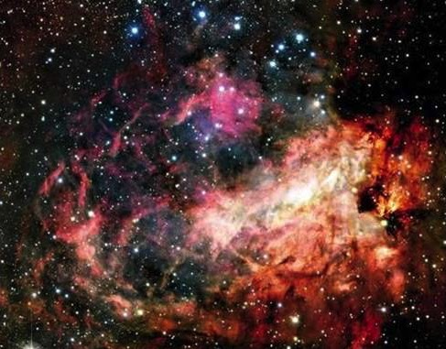
Sun & Moon
God's Creation…Day 4
And let them be for lights in the expanse of the heavens to give light on the earth”; and it was so (15).

Slide 29
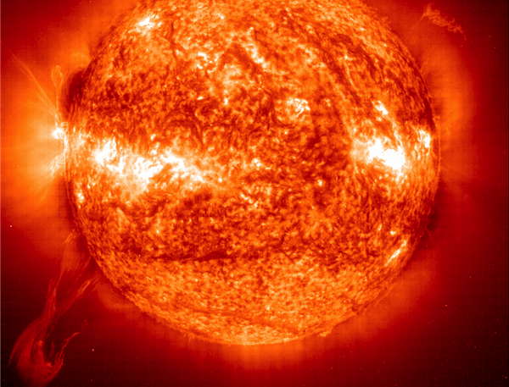
Sun
God's Creation…Day 4
God made the two great lights,
the greater light to govern the day (16a)…

Slide 30
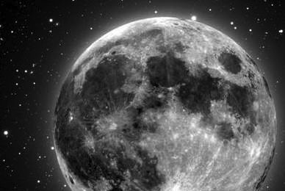
Moon
God's Creation…Day 4
…and the lesser light to govern the night (16b)…

Slide 31
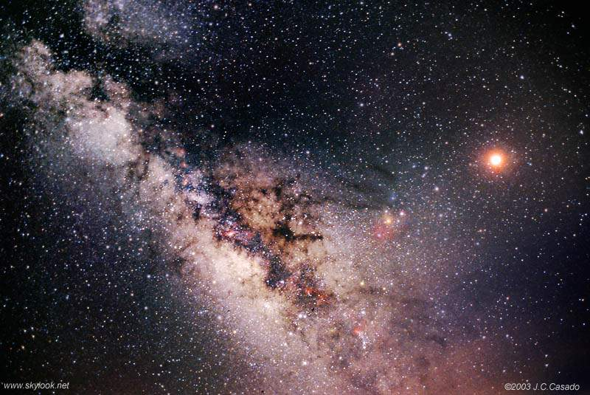
Stars
God's Creation…Day 4
He made the stars also (16c).

Slide 32
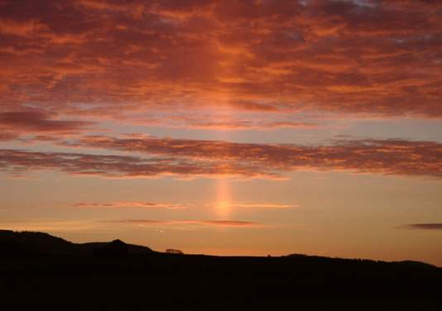
Fourth Day
God's Creation…Day 4
God placed them in the expanse of the heavens to give light on the earth, and to govern the day and the night, and to separate the light from the darkness; and God saw that it was good. There was evening and there was morning, a fourth day (17-19).

Slide 33
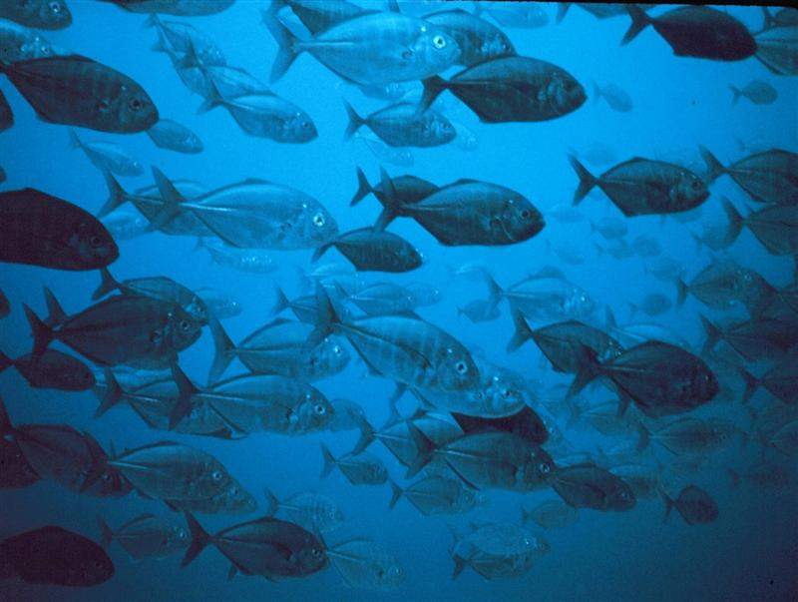
Day 5
God's Creation…Day 5
Then God said,
“Let the waters teem with swarms of living creatures…” (20a)

Slide 34
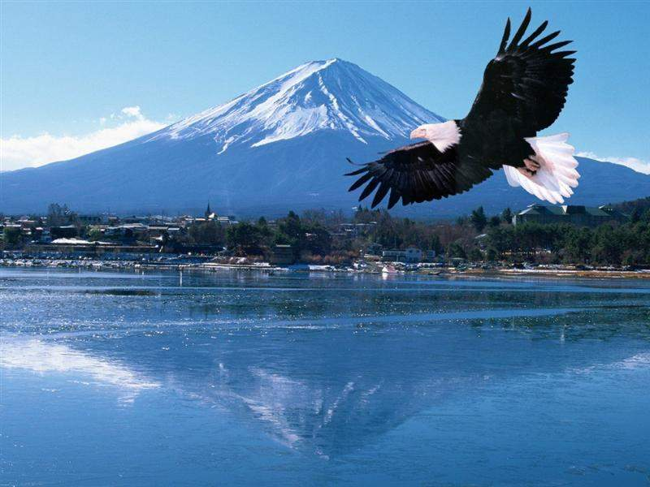
Birds
God's Creation…Day 5
“…and let birds fly above the earth in the open expanse of the heavens” (20b).

Slide 35
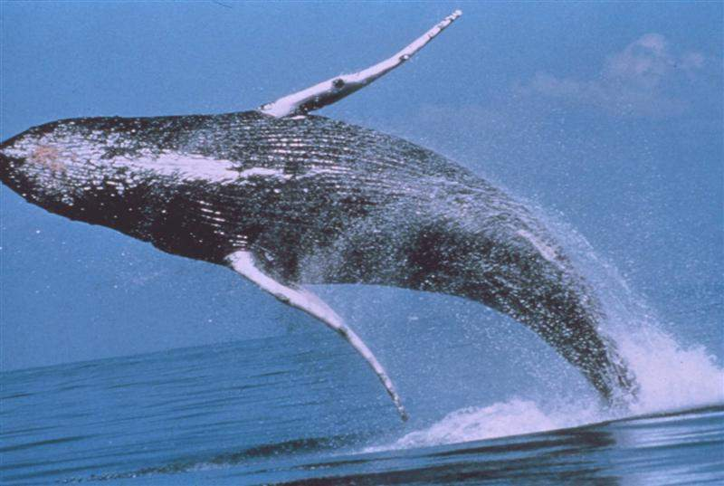
Whales
God's Creation…Day 5
God created the great sea monsters and every living creature that moves, with which the waters swarmed after their kind (21a)…

Slide 36
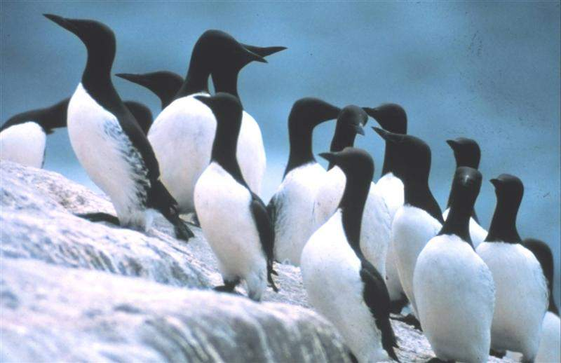
Penguins
God's Creation…Day 5
…and every winged bird after its kind; and God saw that it was good (21b).

Slide 37
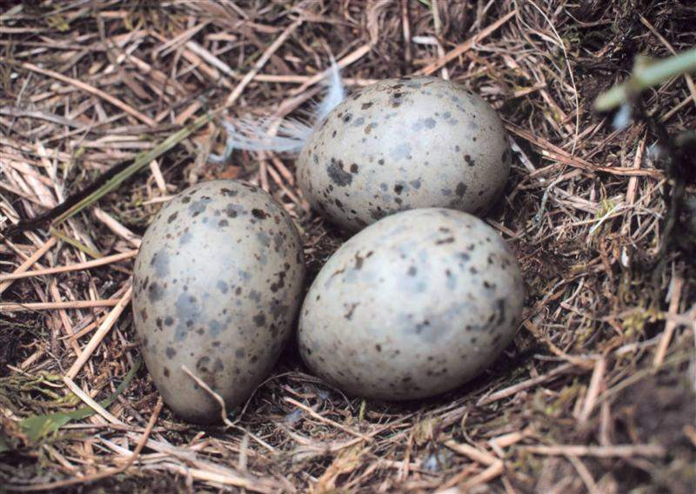
Multiply
God's Creation…Day 5
God blessed them saying, “Be fruitful and multiply, and fill the waters in the seas, and let the birds multiply on the earth” (22).

Slide 38

Fifth Day
God's Creation…Day 5
There was evening and there was morning, a fifth day (23).

Slide 39
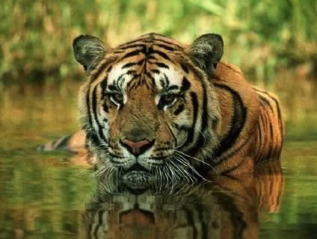
Animals
God's Creation…Day 6
Then God said, “Let the earth bring forth living creatures after their kind: cattle and creeping things and beasts of the earth after their kind”; and it was so. God made the beasts of the earth after their kind, and the cattle after their kind, and everything that creeps on the ground after its kind; and God saw that it was good (24-25).

Slide 40

Man
God's Creation…Day 6
Then God said, “Let Us make man in Our image, according to Our likeness; and let them rule over the fish of the sea and over the birds of the sky and over the cattle and over all the earth, and over every creeping thing that creeps on the earth” (26).

Slide 41
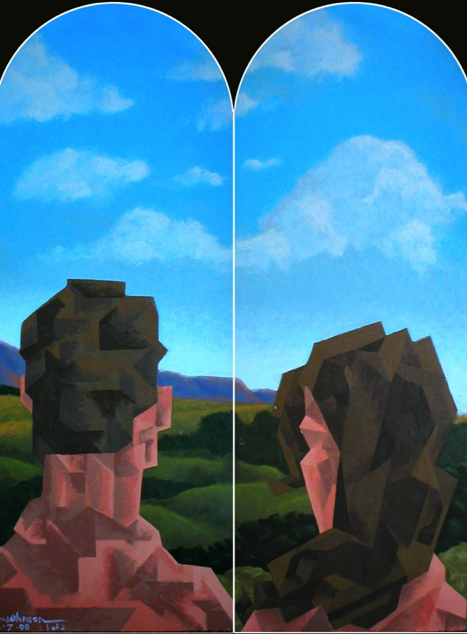
Woman
God's Creation…Day 6
So God created man in his own image
in the image of God he created him
male and female he created them (27).

Slide 42
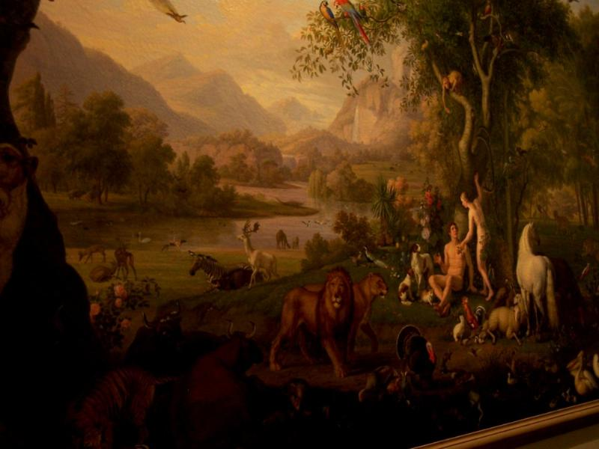
Mandate
and over the birds of the air
And God blessed them, and God said to them, “Be fruitful and multiply, and fill the earth and subdue it;
and have dominion over the fish of the sea
and over every living thing that moves upon the earth” (28).

Slide 43

Food
Then God said, “Look, I have given you every green plant yielding seed that is on the surface of all the earth, and every tree which has fruit yielding seed; it shall be food for you” (29)

Slide 44
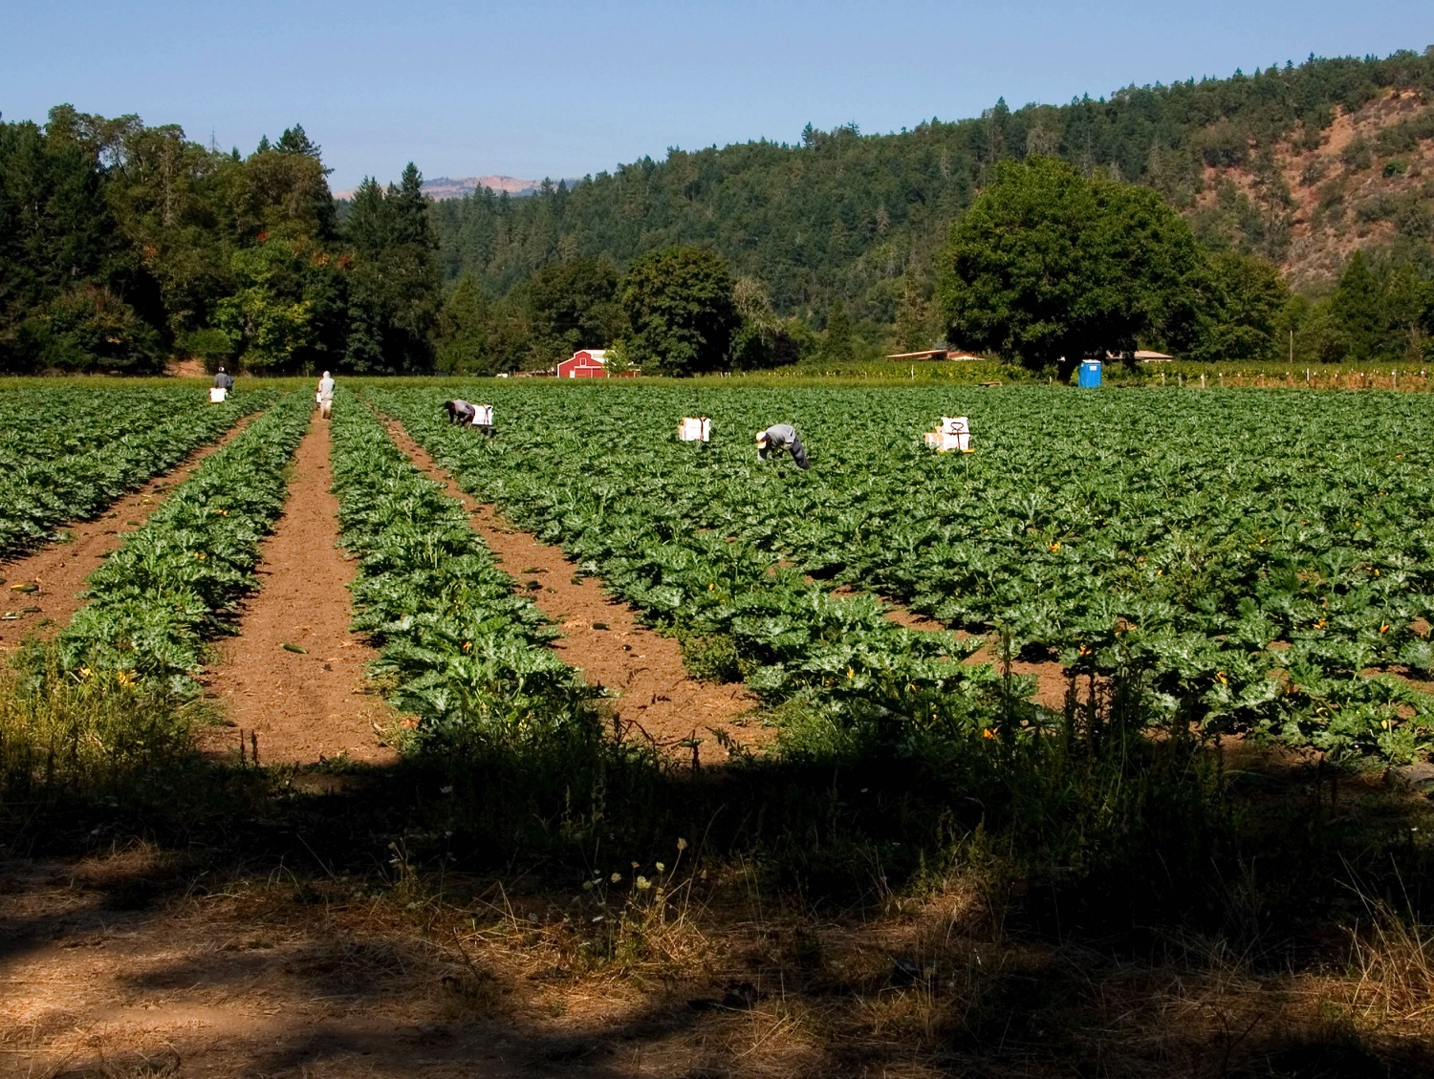
Food
“and to every beast of the earth and to every bird of the sky and to every thing that moves on the earth which has life, I have given every green plant for food”; and it was so (30).

Slide 45
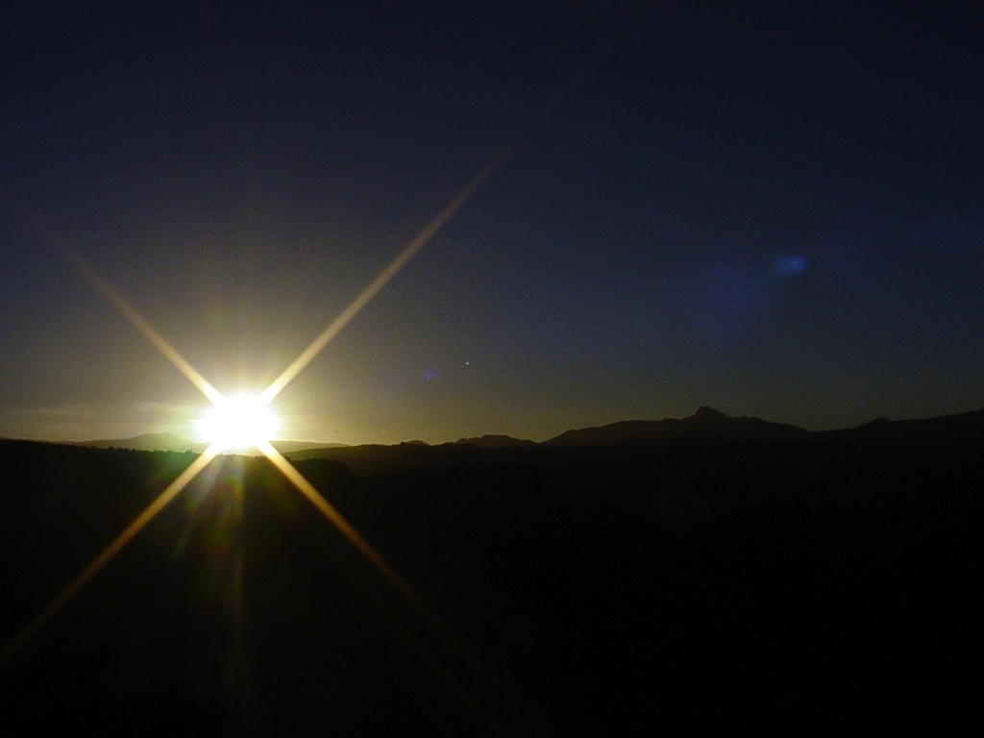
Sixth Day
God's Creation…Day 6
God saw all that He had made, and it was very good.
And there was evening and there was morning, the sixth day (31).

Slide 46
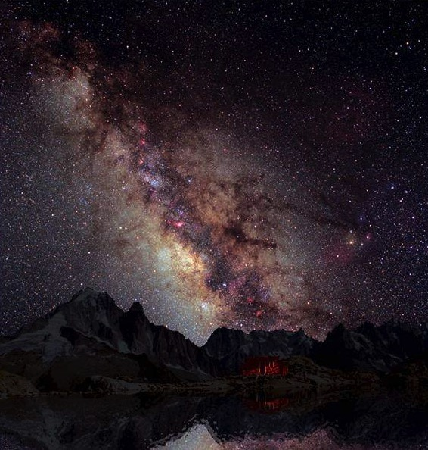
Summary
God's Creation…Day 7
Thus the heavens and the earth were completed,
and all their hosts (2:1)

Slide 47
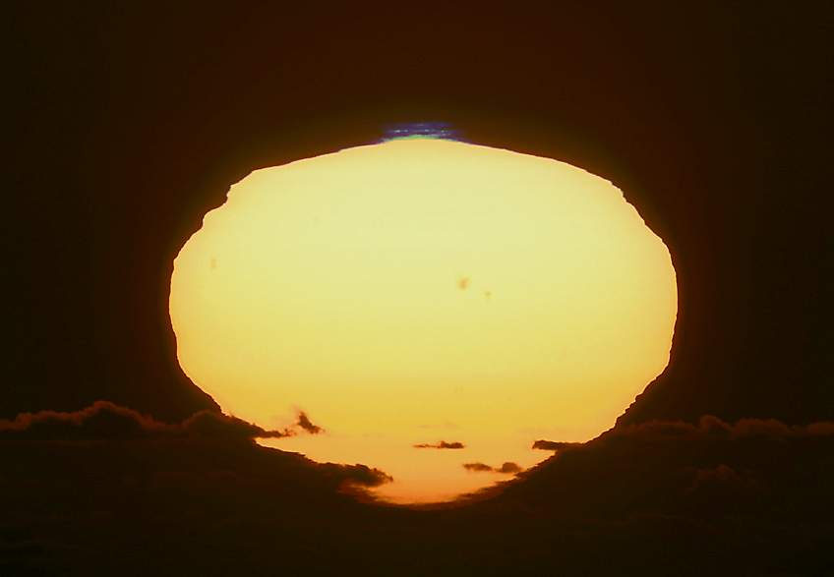
Day 7
God's Creation…Day 7
By the seventh day God completed His work which He had done, and He rested on the seventh day from all His work which He had done (2:2).

Slide 48
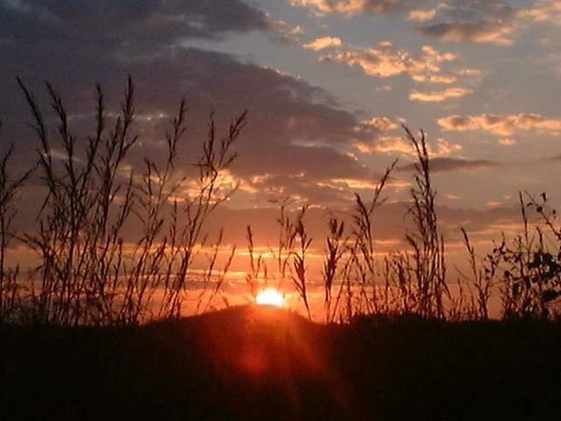
Sabbath
God's Creation…Day 7
Then God blessed the seventh day and sanctified it, because in it He rested from all His work which God had created and made (2:3).

Slide 49
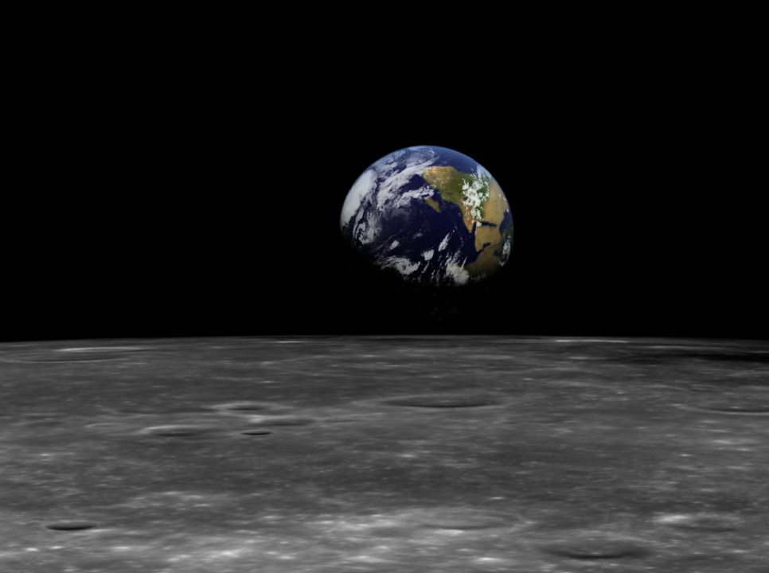
God as King in Genesis 1
Uncreated God (1:1)
Creation by Word alone (1:4)
Creation with ease
Sun and moon [gods] created (1:16)
Shared rule with man (1:26)
Notes:
Over and over in Genesis 1 we see evidence that God is King

Slide 50
Days of Creation
33
Void
Formless
Forming
Filling
Day 4: Sun, moon & stars arranged
Day 1: Light
Day 2: Water & air separated
Day 5: Fish & fowl
Day 3: Land & sea separated
Day 6: Animals & man
Genesis 1:3-31
Notes:
The account is as straightforward as you’d expect—form before filling.

Slide 51
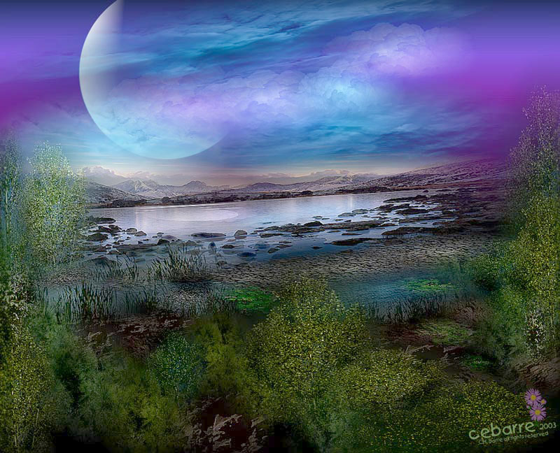
II. Creationism and God's Kingship are continually attacked today.

Slide 52
Creation Theories
24-Hour Day
1 day = literal 24 hours
Day-Age
1 day = indefinite era
Literary
7 days = symbolic
Prior Creation
Creation | Gap | Re-Creation
1:1 1:2-2:3
Two-Phase
Creation | Gap | Creation
1:1-2:3 2:4-25
Genesis 1
Notes:
Four unacceptable theories play with the text of Genesis 1

Slide 53
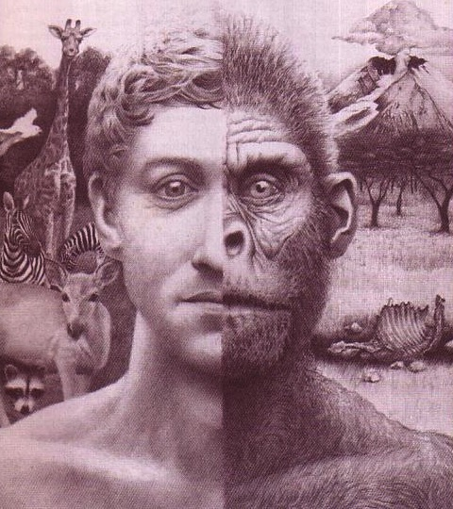

Creation or Evolution?
Notes:
We must choose creation over evolution. Decide who your real father is!

Slide 54
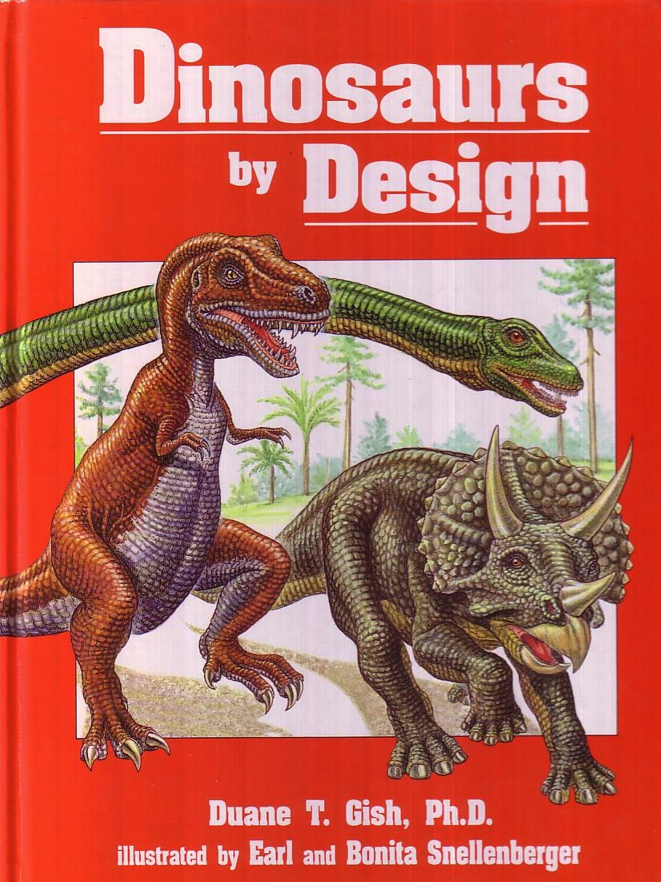
God created dinosaurs on the sixth day of creation
Notes:
We must admit that the normal reading here is that God created all animals—even dinosaurs—on the sixth day.

Slide 55
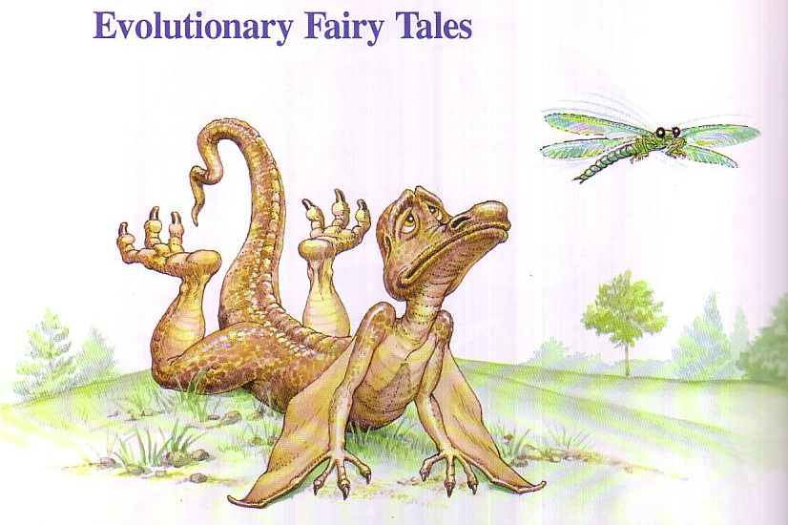

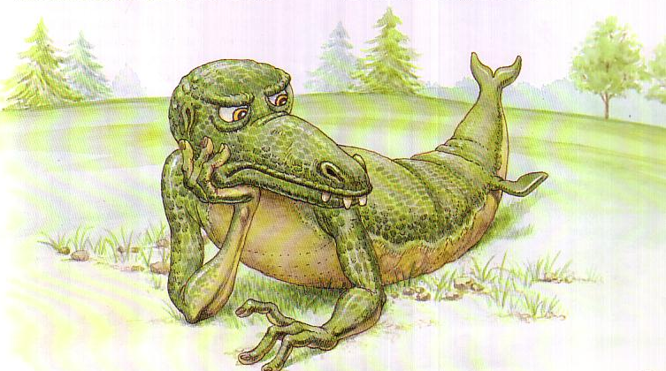
Evolution relies on a theory of transitional forms which would have been easy prey!
75
Evolutionary Fairy Tales
Notes:
No evolution artists draw pictures of useless animals waiting for wings to grow or fins to turn into legs. Such animals would be such easy prey that they would have died out rather than evolved!

Slide 56

Expelled Movie Clip
Notes:
The 2008 movie “Expelled” by Ben Stein shows the anti-God bias of the modern scientific world, whose evolution bias is dubbed “No Intelligence Allowed” in a pun on the refusal to even consider ID: Intelligent Design. Ben Stein is a Jew—not a Christian—but he shares in common with us belief in the Genesis account. It highlights expelled creationists and then of atheists who shun them. The movie hardly showed even in the USA where it was made let alone overseas. I wrote the movie theatres to request it but never got a response. Let’s see the teaser trailer [see 1 min. http://www.expelledthemovie.com/video.php].

Slide 57
Black
Notes:
(So what should we do? How do we respond to the pagan philosophies of our day?)

Slide 58

III. We must defend against attacks on God as Creator and King.
Notes:
Defend a face-value interpretation of Genesis 1.

Slide 59

The 24-Hour View
WHEW!!... I just created a 24-hour period of alternating lightness and darkness on earth…
What are you going to do now?
What are you going to do now?
Call it a day…
Notes:
“Whew! I just created a 24-hour period of alternating light and darkness,” God says. “What are you going to do now?” an angel asks. God: “Call it a day.”
We should not be deterred from holding to a normal reading of Genesis 1 as literal 24-hour days.

Slide 60

Why 24 Hours?
70b
Instantaneous creation
“By the word of the LORD were the heavens made, their starry host by the breath of his mouth” (Ps. 33:6)
“There is certainly no thought here of delay, or a trial-and-error process, or a gradual, step-by-step fulfillment”
– John Whitcomb, The Early Earth, 24
Notes:
Genesis describes God’s creative work as instantaneous. He spoke, and it came into being. This excludes long, drawn-out processes for creation over centuries.

Slide 61
Why 24 Hours?
70b
Instantaneous creation (Ps. 33:6)
“evening and morning”
Notes:
The repeated formula “there was evening and there was morning–the first [etc.] day" (Gen. 1:3, 8, 13, 19, 23, 31) surely indicates a literal time element, for one cannot have morning without sunrise and evening without sunset. The same phrase appears in Daniel 8:26 (cf. 8:14) in reference to 2300 days. Further, Leupold notes that the words for “evening” and “morning” in the OT never refer to long periods of time (Genesis, 1:56).

Slide 62

Dan. 8:26 alone (besides Gen 1) has “evening & morning”
––with a literal view
“The vision of the evenings and mornings which has been told is true; But keep the vision secret, for it pertains to many days in the future” (NASB).

Slide 63
Why 24 Hours?
Instantaneous creation (Ps. 33:6)
“evening and morning”
Numerical adjective (“first…”)
In Hebrew, when “day” (yom) is preceded by a numericial adjective, “day” is always literal!
Notes:
While “day” sometimes refers to a period of time as in Genesis 2:4, the use of a numerical adjective (“first,” “second,” etc.).

Slide 64

Numbers 7:12
“Now the one who presented his offering on the first day was Nahshon…”
Notes:
The word “day” (yom) elsewhere limits this “day” to a literal 24-hour period (cf. Num. 7:12, 18, 24, 30, etc.).

Slide 65
Why 24 Hours?
Instantaneous creation (Ps. 33:6)
“evening and morning”
Numerical adjective (“first…”)
Pattern for work & rest
Notes:
This creation week sets a pattern for man’s work cycle as explained in the fourth commandment (Exod. 20:11; 31:17). As God worked in the daytime during literal 24-hour days, so man works in the daytime and rests at night.

Slide 66

We get our 7-day week from Genesis 1

Slide 67
Why 24 Hours?
Instantaneous creation (Ps. 33:6)
“evening and morning”
Numerical adjective (“first…”)
Pattern for work & rest
Sun & moon not until day 4
Notes:
The fact that the sun and moon were not created until the fourth day argues for a literal interpretation (1:14-19). Could the preceding days be long eras of time—like “morning” and “evening” were each 1000 years? How then could plant life sustain itself for centuries without light? However, such is possible in a 24-hour period. The text specifically says that these “lights” were made to govern “days” in the normal sense of the word (1:14, 16, 18).

Slide 68

Protect your foundational belief in Creation!
Notes:
What else can you do besides have a normal reading of Genesis 1? You need to…

Slide 69

Psalm 11:3 KJV 00422
Psalm 11:3
If the foundations be destroyed, what can the righteous do?
Notes:
Psalm 11:3 reminds us that foundations are vital.

Slide 70

House 1 00418
Notes:
A house may be built strong…

Slide 71

House 2 00419
Notes:
But surround it with heavy machinery that hurts the foundation…

Slide 72

House 3 00420
Notes:
Then even a strong foundation will crumble.

Slide 73


Blocks-Genesis Doctrine & Doctrines 00405
2ND COMING
1ST COMING
LAST ADAM
CURSE
DOMINION
DOCTRINE
WORK
7-DAY WEEK
GENESIS
GENESIS
Notes:
The foundation of all our doctrine is Genesis.
• Here we get our belief in the seven-day week, work, dominion, the curse, and Christ as the last Adam who came once to resolve the curse and will come back to rule.

Slide 74

Blocks-God's Word & Man's Opinion 00403
MEANING
OF LIFE
ABORTION
STANDARDS
PORNOGRAPHY
MARRIAGE
HOMOSEXUALITY
LAWS
LAWLESSNESS
CREATION
GOD'S
WORD
EVOLUTION
MAN'S
OPINION
Notes:
Creation is the foundation of laws, marriage, standards and meaning in life.
But the switch from a foundation in creation to evolution brought us disaster.
It has led to lawlessness, homosexuality, pornography, and abortion.

Slide 75
Q335-Sagan 00434
The secrets of evolution are time and death. Time for the slow accumulations of favorable mutations, and death to make room for new species.
Carl Sagan, program entitled "One Voice in the Cosmic Fugue."
© 2003 Answers in Genesis

Slide 76

Evolution: Death-Man 00413
EVOLUTION
MAN'S EXISTENCE
DEATH
Bloodshed
Suffering
Disease
Notes:
Based on evolution, now we accept death as normal. We have deceived ourselves into thinking that death has brought us to a high position today!

Slide 77

Creation: Actions-Death 00412
CREATION
MAN'S ACTIONS
Notes:
In reality, we have degenerated from a high position to a low position due to sin, which leads to death.

Slide 78

Reinterpretations 00363
Notes:
The cracked foundation in Genesis has led to reinterpretations that make evolution look good and the Bible look bad.

Slide 79
Black
Notes:
So what have I said (MPs)?

Slide 80

Key Thoughts Today
I. Our God is King who created everything in contrast to man-made ideas (Gen. 1).
II. Creationism and God's Kingship are continually attacked today.
III. We must defend against attacks on God as Creator and King.

Slide 81

Main Idea
How do we fight the pagan philosophies of our day?
Defend God
as Creator and King!
Notes:
So what’s the main idea? It’s the answer to my question earlier…

Slide 82

Balloons problem—evol vs creat
Gay
Marriage
THE
PROBLEM
Abortion
PSALM 11:3
Moral
Relativism
Euthanasia
CHRISTIANITY
HUMANISM
EVOLUTION
CREATION
Notes:
82
We often attack the results of humanism rather than the cause: evolution. At the same time they are attacking our foundation in creationism. Sometimes we even help them by attacking it ourselves!
The humanistic philosophies all are undermining the very foundation of what Christians believe by focusing their attacks at creation.
Meanwhile, Christians accept their evolutionary theory and then focus our attacks at the results of humanism instead of attacking the foundation in evolution.
Some Christians shoot their own foundation and others are asleep or shooting other Christians.

Slide 83

Balloons problem—man's vs God's word
THE
SOLUTION
ISAIAH 58:12
Gay
Marriage
Moral
Relativism
CHRISTIANITY
HUMANISM
MAN'S WORD
GOD'S WORD
Notes:
83
Instead of attacking the results of evolution, we need to attack their foundation—evolution itself.

Slide 84

AiG Web Address 00439
Notes:
One way to do this is to equip yourself from the hundreds of articles at answersingenesis.org or PPTs at BibleStudyDownloads.org.

Slide 85

BibleStudyDownloads.org

Slide 86

BibleStudyDownloads.org

Slide 87

BibleStudyDownloads.org

Slide 88

BibleStudyDownloads.org

Slide 89
Expelled Movie Clip
YouTube: escapingplatoscave

Slide 90

The Lord of Creation can also take care of you!

Slide 92


OT Survey link at BibleStudyDownloads.org
Get this presentation for free!
Notes:
OT Survey (os)

